Slide 1
INTRODUCTION TO ASP.NET CORE
By: Bhawna Gunwani

Slide 2
ASP.NET CORE

Slide 3
ASP.NET Web API Fundamentals

Slide 4
AGENDA
Convention Routing and Attribute Routing
Route Constraints
Action Methods and Result Types
Content Negotiation
Media Type Formatters
Model Binding
Model Validation
Demo: Handling Validation Errors

Slide 5
Routing- Convention and Attribute Routing

Slide 6
CONVENTION ROUTING
It is used for defining routes based on conventions and defaults,
rather than explicitly defining each route.
Developers define a set of conventions that are used to generate routes for different types of controllers and actions.
It provides a simple and flexible way to define routes in an ASP.NET Core application.
The URL pattern is generated based on the names of the controller and action methods.

Slide 7
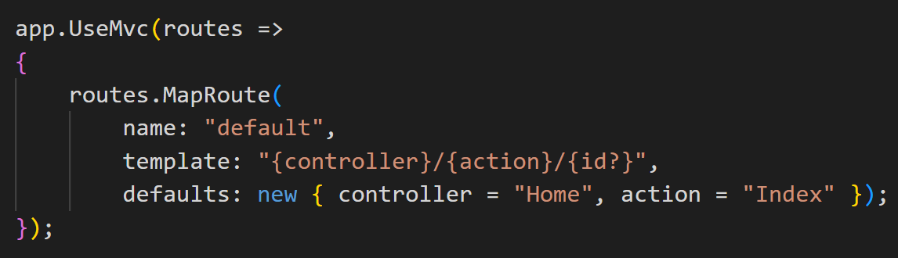
CONVENTION ROUTING
For example, consider the following code:
This code sets up a default route that maps URLs in the format of /{controller}/{action}/{id}.
When a request arrives, the routing middleware uses this route definition to match the incoming URL to the appropriate controller and action method.

Slide 8
ATTRIBUTE ROUTING
It is a technique used for defining routes directly in the controller code using attributes.
Developers can specify the URL pattern for a particular action method using attributes,
instead of relying on conventions or explicit route definitions.
In attribute routing, [Route] attribute is used to specify the URL pattern for an action method.
By specifying the route directly in the controller code, developers can have fine-grained control over the URL patterns for each action method.

Slide 9
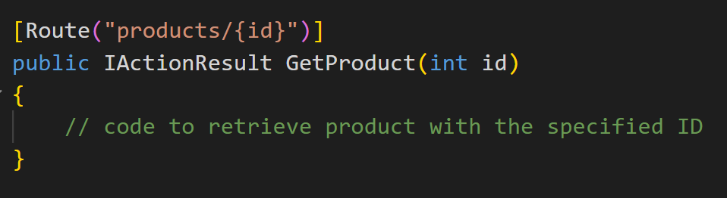
ATTRIBUTE ROUTING
For example, consider the following code:
In this example, the [Route] attribute specifies that the GetProduct method should be invoked for URLs in the format of /products/{id}.
The {id} placeholder in the URL pattern is replaced with the value of the id parameter.

Slide 10
Route Constraints

Slide 11
ROUTE CONSTRAINTS
Routing constraints let you restrict how the parameters in the route template are matched.
It helps to filter out the input parameter and action method it can accept.
For example, if the URL Parameter is restricted to have int value, the route engine will match the controller action having integer value in the parameter or restrict it.
There are several built-in route constraints that can be used.

Slide 12
ROUTE CONSTRAINTS
Constraint | Description | Example
alpha | Matches uppercase or lowercase Latin alphabet characters (a-z, A-Z) | {x:alpha}
bool | Matches a Boolean value. | {x:bool}
datetime | Matches a DateTime value. | {x:datetime}
int | Matches a 32-bit integer value. | {x:int}
float | Matches a 32-bit floating-point value. | {x:float}
length | Matches a string with the specified length or within a specified range of lengths. | {x:length(6)} {x:length(1,20)}
max | Matches an integer with a maximum value. | {x:max(10)}
min | Matches an integer with a minimum value. | {x:min(10)}
range | Matches an integer within a range of values. | {x:range(10,50)}
regex | Matches a regular expression. | {x:regex(^\d{3}-\d{3}-\d{4}$)}

Slide 13
Content Negotiation

Slide 14
CONTENT NEGOTIATION
Whenever we consume an API, we receive data in either JSON or XML or plain text or your own
custom format.
i.e. the requester and responder are aware of the format in which they will receive data.
This is nothing but Content Negotiation.
Depending on the Accept header value in the request, the server sends the response.

Slide 15
HOW CONTENT NEGOTIATION WORKS?
There are two main headers which hold the responsibility of content negotiation
Content-Type
Accept
When a requester send a service request,
the CONTENT-TYPE tells responder the format he will receive data
whereas the ACCEPT header tells in which format the requester requires the data.

Slide 16
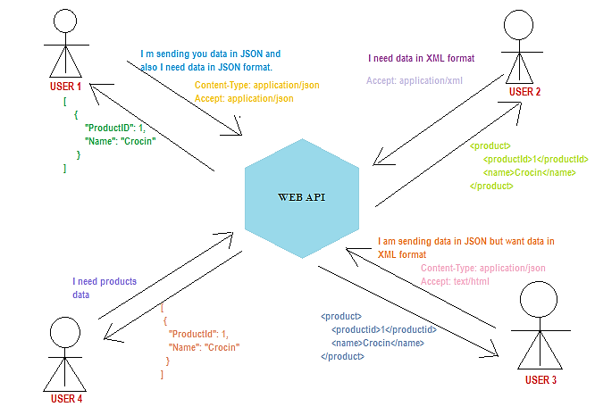
HOW CONTENT NEGOTIATION WORKS?

Slide 17
HOW CONTENT NEGOTIATION WORKS?
In the above pictorial view, there are few points which should be noted down,
User 2 didn’t mention Content-Type but then received the response in desired format. i.e. XML.
Whereas User 4 didn’t mention both Content-Type as well as Accept header.
But then received the response. I.e. in JSON format.
In short, JSON format is the default content negotiator in web API.
Also, User 3 requires data in text/html format but receives data in XML format.
In short, text/html Accept header sends response in XML format by default.

Slide 18
Media Type Formatters

Slide 19
MEDIA-TYPE FORMATTERS
You have learnt above that Web API handles JSON and XML formats based on Accept and
Content-Type headers.
But, how does it handle these different formats?
The answer is: By using Media-Type formatters.
Media type formatters are classes responsible for serializing request/response data,
so that Web API can understand the request data format and send data in the format which
client expects.

Slide 20
MEDIA-TYPE FORMATTERS
Web API includes following built-in media type formatters.
Media Type Formatter Class | MIME Type | Description
JsonMediaTypeFormatter | application/json, text/json | Handles JSON format
XmlMediaTypeFormatter | application/xml, text/json | Handles XML format
FormUrlEncodedMediaTypeFormatter | application/x-www-form-urlencoded | Handles HTML form URL-encoded data
JQueryMvcFormUrlEncodedFormatter | application/x-www-form-urlencoded | Handles model-bound HTML form URL-encoded data

Slide 21
MEDIA-TYPE FORMATTERS
Get Request
Web API Controller
Accept:application/json
.Net Types
Ex: Employee
Client
Media Type Formatter
XML, JSON etc.
Post Request
ContentType:application/json

Slide 22

Thank You

